Slide 1
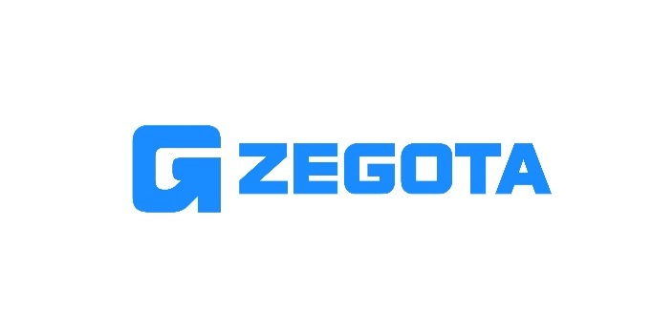

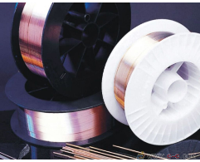
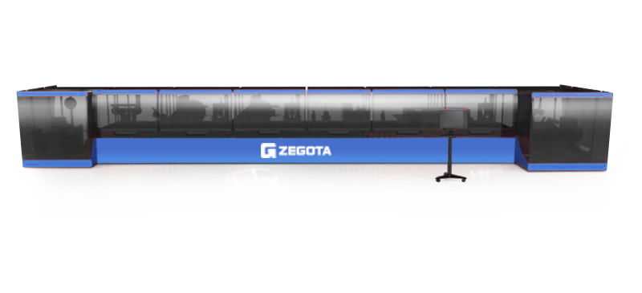
Dedicated on Wire Precision Cold Rolling Technology & Products
Zhejiang Zegota Precision Technology Co., Ltd. is a leading company for wire precision cold rolling and forming technology. We dedicate to apply this new super-precision technology to more and more industries.
Headquartered in Jiaxing, Zhejiang Province, we have established a large production base and planned a number of multi stands rolling production lines with total capacity of 20,000 tons.
Now, we can provide customers in automotive, consumer electronics, new energy, metrology, electric power and medical industries, etc. with our precision profiled wire, medical implants, scroll spring flat strip, wiper flat strip, seat and skylight slide rail, precision filter wire, flat square copper wire, flat bead wire, consumer electronic profiles, flat square wire products, etc.

Slide 2
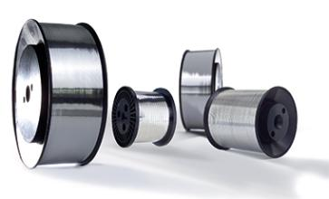
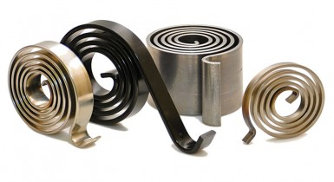
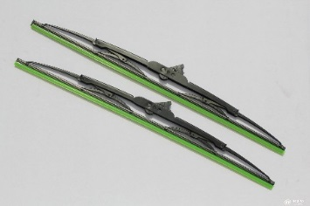
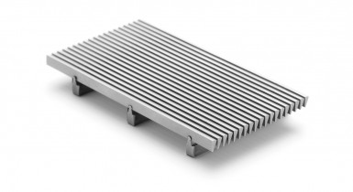
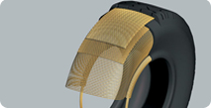
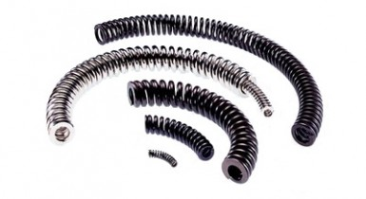
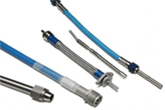
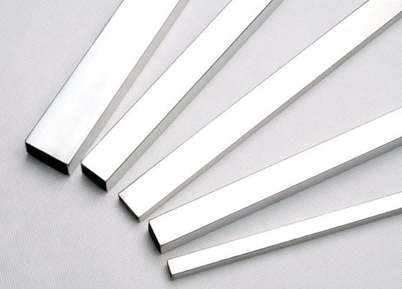
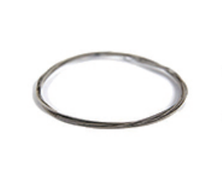
Dedicated on Wire Precision Cold Rolling Technology & Products
Precision flat & Square Wire
High Precision, High Strength & Custermised
Specification
Material | High quality carbon steel Stainless Steel Special Non-ferrous mtal
Dimension | Thickness: 0.2-3.5 mm Width : 1.0-13 mm
Tolerance | Thickness: +/-0.003 mm Width : +/-0.008 mm
R Angle Type | Natural Angle, R Angle, Special Angle, Rolling Forming Angle
Surface treatment | Polishing, brightening surface, phosphating treatment, fogging surface
Packaging | Coil (Weight of each coil: 40 - 1,000 kg)
Application | Automobile, metrology, medical treatment, new energy and consumer electronics, etc.
Typical application
Spiral spring
Wiper blades
Filter
Flat bead wire
Clutch spring
Cable armor
Metrology
Piston Ring Flat Wire

Slide 3
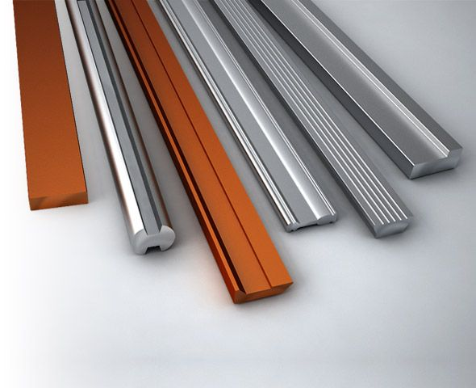
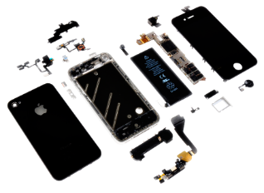
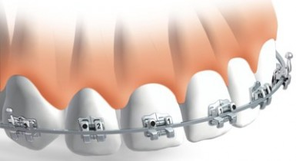
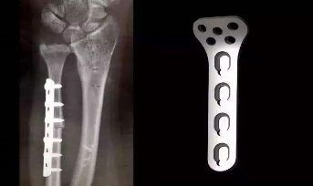
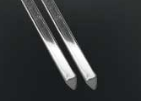
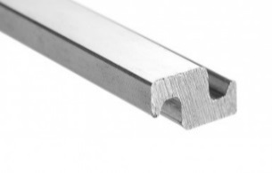
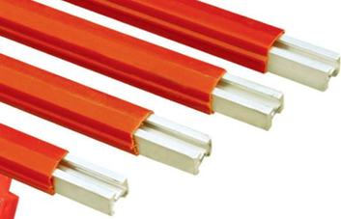
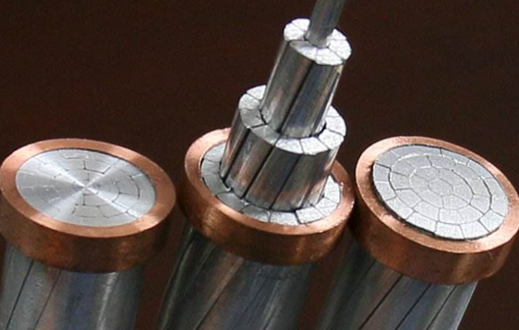
Dedicated on Wire Precision Cold Rolling Technology & Products
Profiled Section Wire
High Precision, High Strength & Custermised
Specification
Material | High quality carbon steel Stainless Steel Special Non-ferrous mtal
Shape | Trapezoidal, I-shaped and various complex profiled sections to support customer customization
Dimension | Thickness: 0.2 - 8.0 mm Width : 1.0 - 10.0 mm
Tolerance | Thickness: +/-0.003 mm Width : +/-0.008 mm
R Angle Type | Natural Angle, R Angle, Special Angle, Rolling Forming Angle
Surface treatment | Polishing, brightening surface, phosphating treatment, fogging surface
Packaging | Coil (Weight of each coil: 40 - 1,000 kg) Straight-line truncated binding (40-1000 kg per bundle)
Application | Automobile, metrology, medical treatment, new energy and consumer electronics, etc.
Typical application
5G phone component
Braces bracket
Medical implant
Filter Wire
Self locking armour
Spectacle frame
Slides
Profiled steel cable

Slide 4
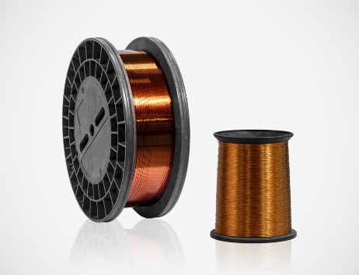
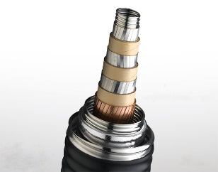
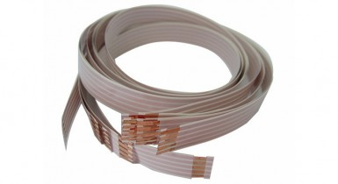
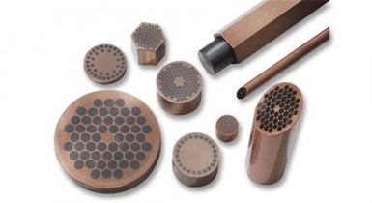
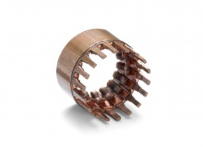
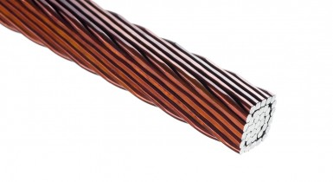
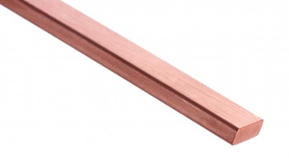
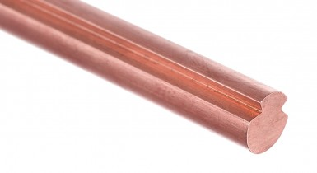
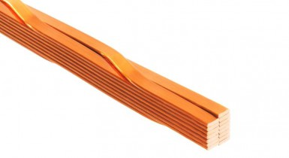
Dedicated on Wire Precision Cold Rolling Technology & Products
Flat and square electric conductors
High Precision, High Strength & Custermised
Specification
Material | Copper Bronze Brass Copper alloy
Dimension | Thickness: 0.03 - 4.5 mm Width : 0.5 - 13 mm Thickness width ratio: No more than 1/50 R Angle : 0.2 - 1.0 mm
Packaging | Coil (Weight of each coil: 40 - 1,000 kg)
Application | New Energy Motor, 48V Drive Unit, Flexible Flat Cable, Connector, Electromagnetic Wire
Industry | Automobile, Medical, New Energy and Consumer Electronics
Typical application
Submarine cable
Flat connection line
Superconductor
commutator
Copper hinge line
Electromagnetic wire
trolley Wire
Transposition conductor

